Slide 1


Slide 2
What is CloudHour?
Objective of CloudHour
Round-table discussion
Focus on a few key topics
Why It's Important
Rapid changes in cloud security and tech
Stay updated and connected for growth as community
How it will benefit the community
Real-time engagement with hosts and community members
Ask open questions and speak your opinion
Opportunity to affect the next agenda
Notes:
Objective of CloudHour
The objective of CloudHour is to create a collaborative space where professionals can come together to discuss, learn, and share insights on the most pressing topics in cloud security and modern workplace technology.
Why its important
CloudHour is important because, in the rapidly evolving landscape of cloud security and workplace technologies, staying updated and connected is crucial for career growth and organizational resilience
How it will benefit the community
By attending CloudHour, community members will have the unique opportunity to engage with industry experts in real-time, ask questions, network with like-minded professionals, and even have the chance to contribute their own expertise by becoming guest speakers in future episodes.

Slide 3

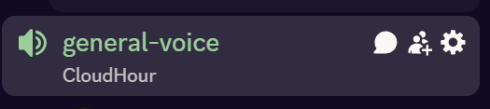
If you prefer to not talk or be asked questions press mute
press mute just mute the mic
If you preferer to chat press

Slide 4
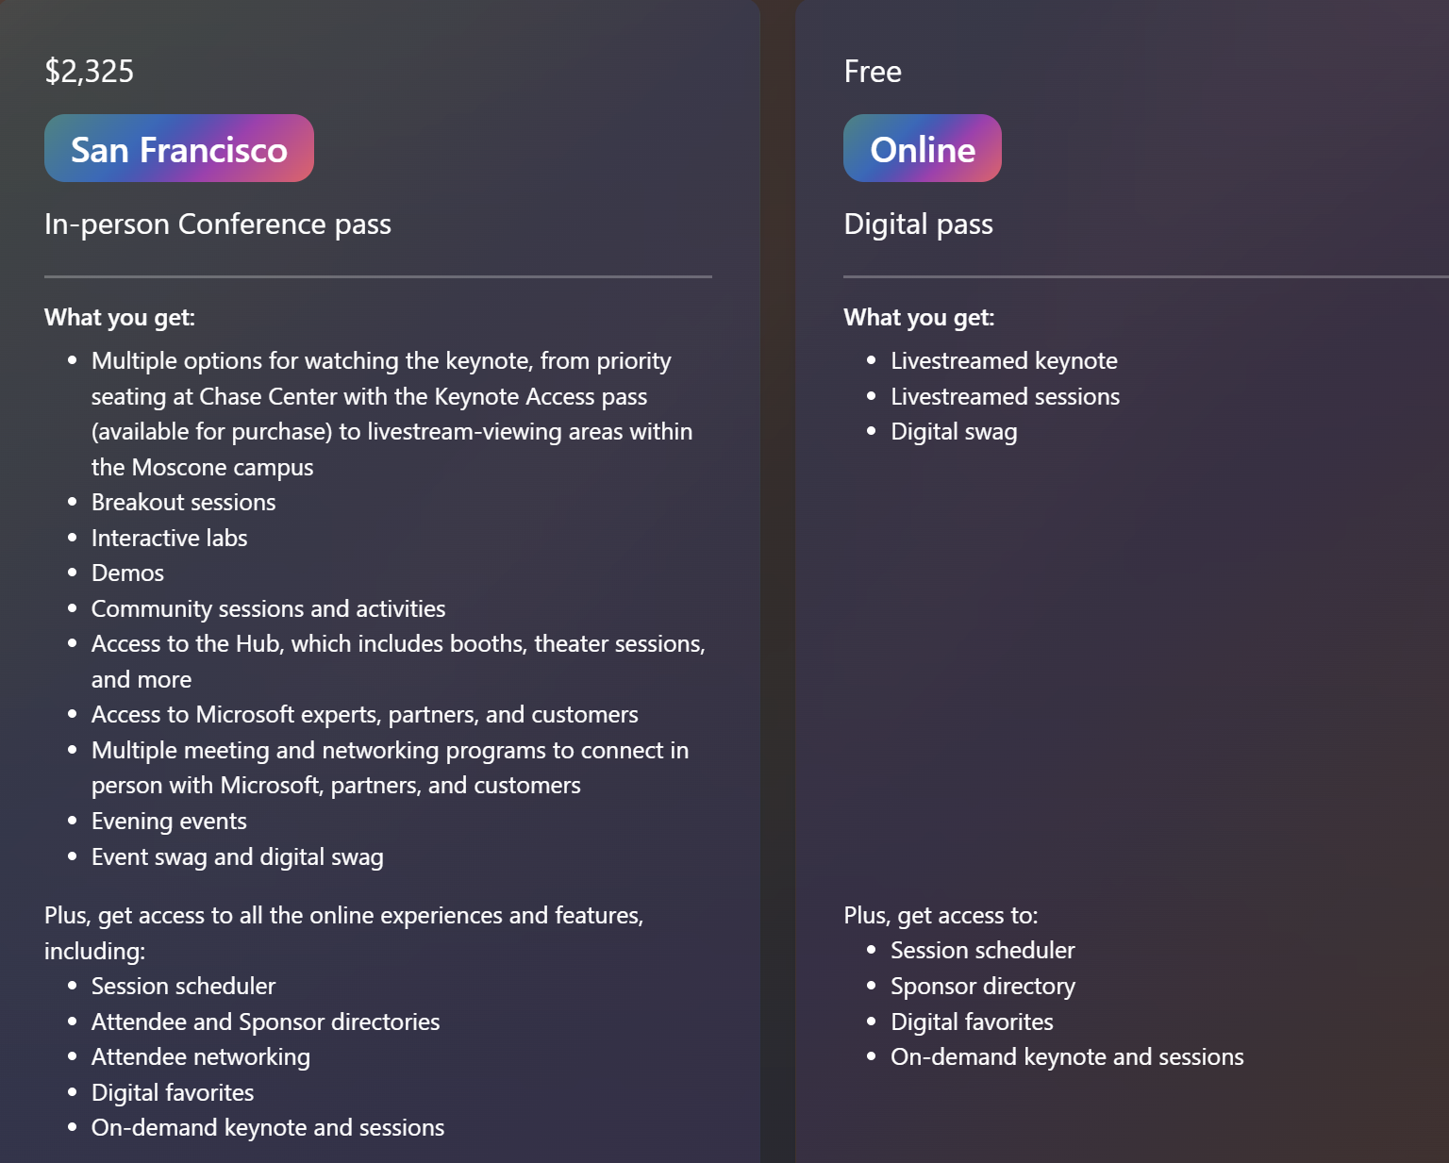
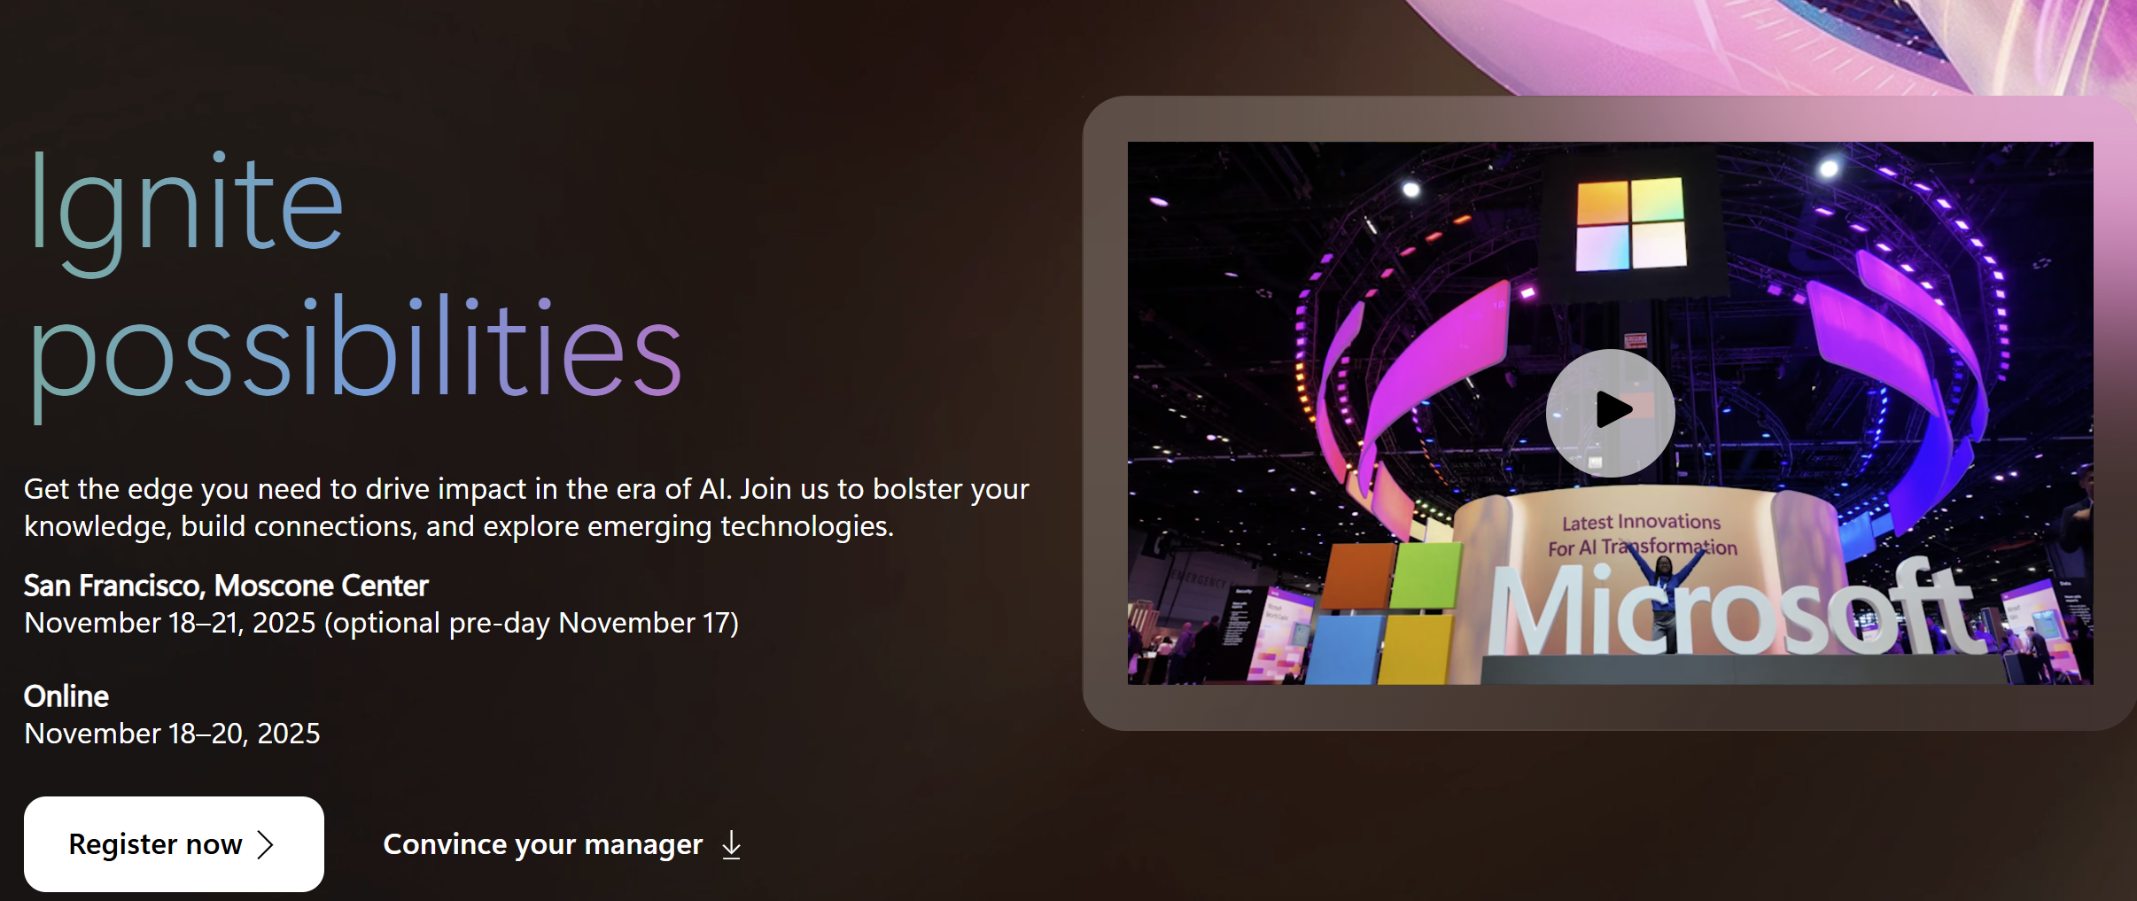
MS Ignite sign-up is open in total $ 3200 or 2.700 EUR (no dinner)
USA, San Francisco
November 18-21 (preday on 17th)
Ticket – ($2325)
Flight from DEN – SF ($790,64)
Hotel pr night $80 pr night (5 nights: $400)
Eat out everyday, every meal $150–$250
Notes:
https://ignite.microsoft.com/en-US/home

Slide 5
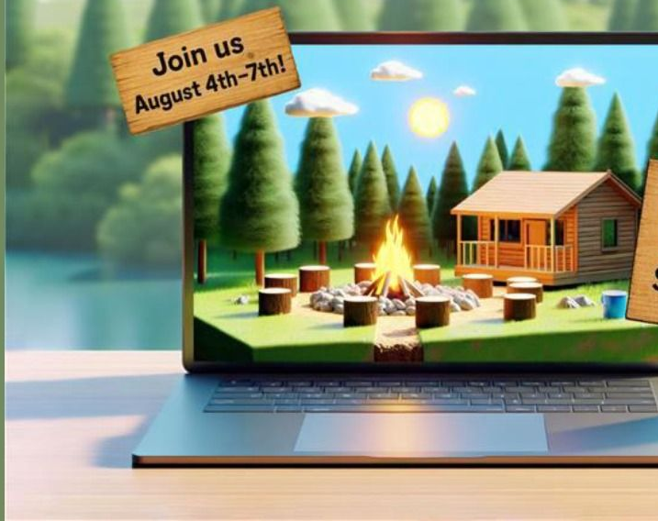
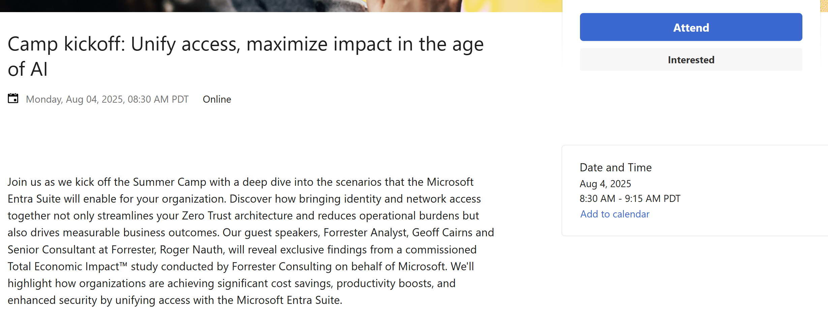
Microsoft Entra Suite Summer Camp: August 4–7, 2025
Aug 4: Unify access. Cut cost. Boost Zero Trust.
Aug 5: Automate least privilege with AI.
Aug 6: Secure any app—no VPN needed.
Aug 7: Detect shadow AI. Govern web use.
Daily: Live demos + expert Q&A.
Attend Online, its free, does not require any NDA
Notes:
https://techcommunity.microsoft.com/event/microsoft-security-events/camp-kickoff-unify-access-maximize-impact-in-the-age-of-ai/4429024

Slide 6
Links to share
Windows 11 25H2
Remove Default MS Store Packages with policy (25H2)
Mastering “App control for business)
Extended Security Updates (Windows 10)
Microsoft Ignite 2025
GSA support for mTLS
App Consent defaults changes
Notes:
Get ready for Windows 11, version 25H2 - Windows IT Pro Blog
A policy to remove Windows apps… – Out of Office Hours
Mastering App Control for Business | Part 1: Introduction & Key Concept - ctrlshiftenter.cloud
https://techcommunity.microsoft.com/blog/coreinfrastructureandsecurityblog/enabling-extended-security-updates-esu-for-windows-10-with-intune/4420182
https://learn.microsoft.com/en-us/entra/global-secure-access/reference-windows-client-release-history#version-2845

Slide 7
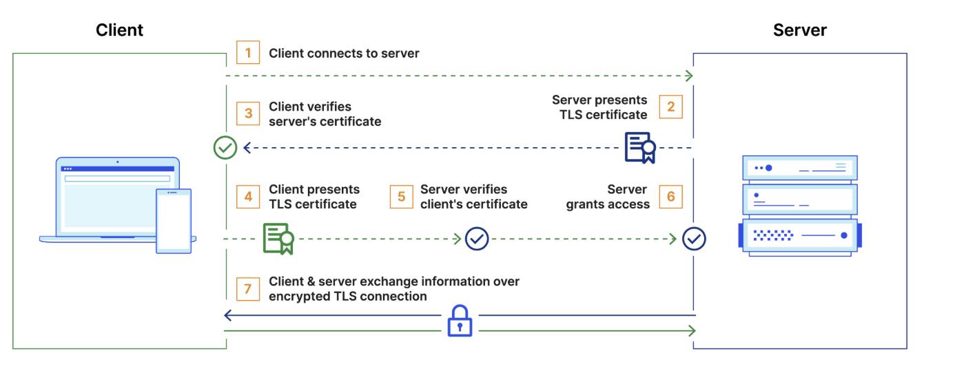
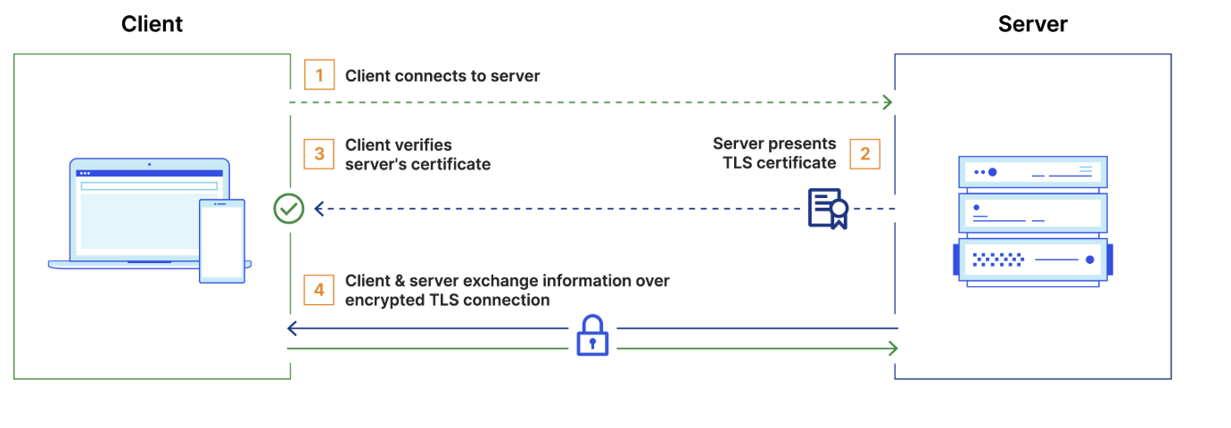
TLS vs mTLS
Notes:
(mTLS verifies both sides of the connection. Not only does the server authenticate itself to the client (as with normal TLS), but the client also proves its identity to the server using a certificate. This stops unauthorized clients from connecting. Better against MITM Attacks)
(This change is like having a digital ID badge scanner at the front door, not just checking who you are, but also making sure the device you're carrying is allowed inside.)
Microsoft: Azure App Gateway. They expose only the frontend via private endpoints or App Proxy
So, unless the device has a valid cert issued by their MDM/PKI, the request never reaches the backend.
Example of other sources: Cloud API Shield
TLS
Client connects to server
Server presents its TLS certificate
Client verifies the server's certificate
Client and server exchange information over encrypted TLS connection
mTLS
Client connects to server
Server presents its TLS certificate
Client verifies the server's certificate
Client presents its TLS certificate
Server verifies the client's certificate
Server grants access
Client and server exchange information over encrypted TLS connection

Slide 8
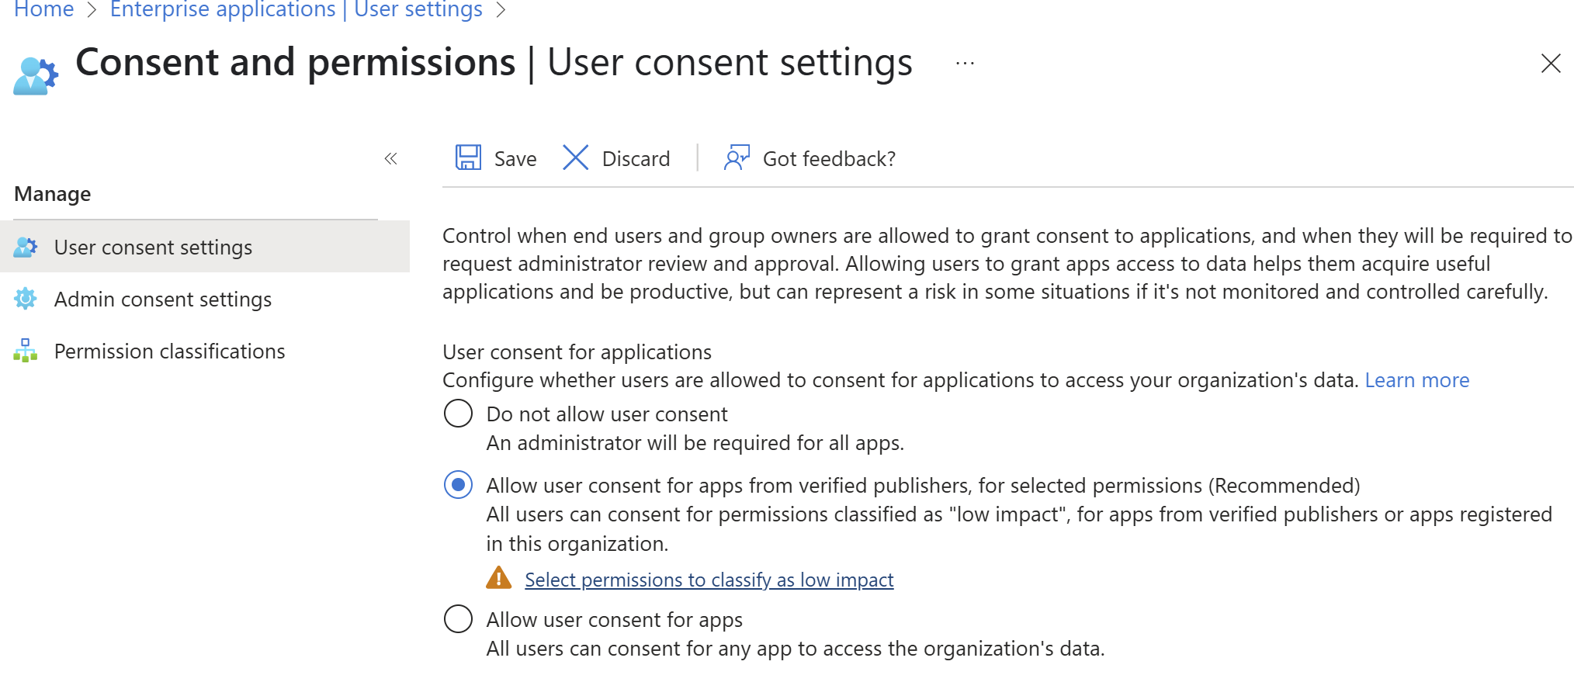
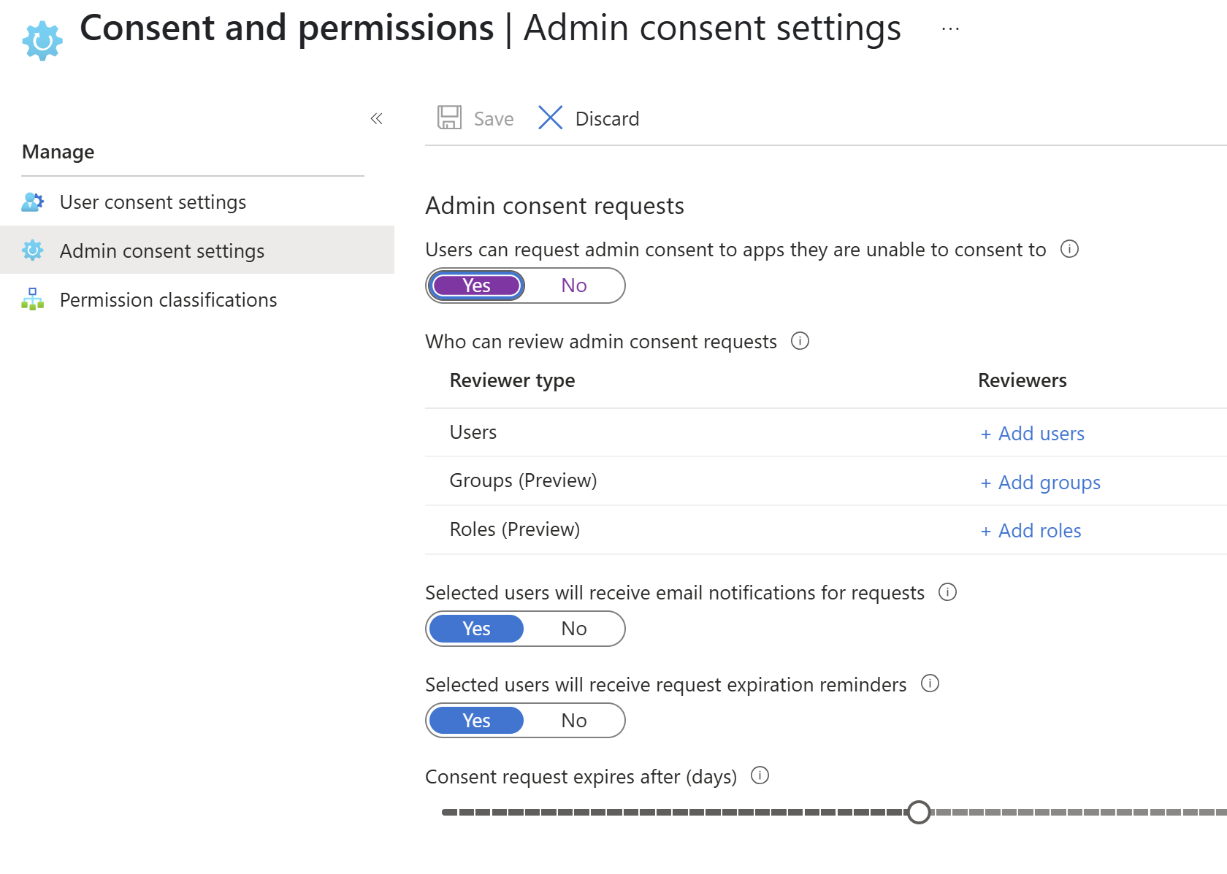
Default App Consent changes
In effect mid July
Block legacy browser authentication to SharePoint and OneDrive
Block FPRPC (FrontPage Remote Procedure Call) protocol for Office file opens
Require admin consent for third-party apps accessing files and sites
Upcoming change won’t affect existing user-consented third-party apps.
Notes:
https://lazyadmin.nl/office-365/new-secure-by-default-changes/

Slide 9
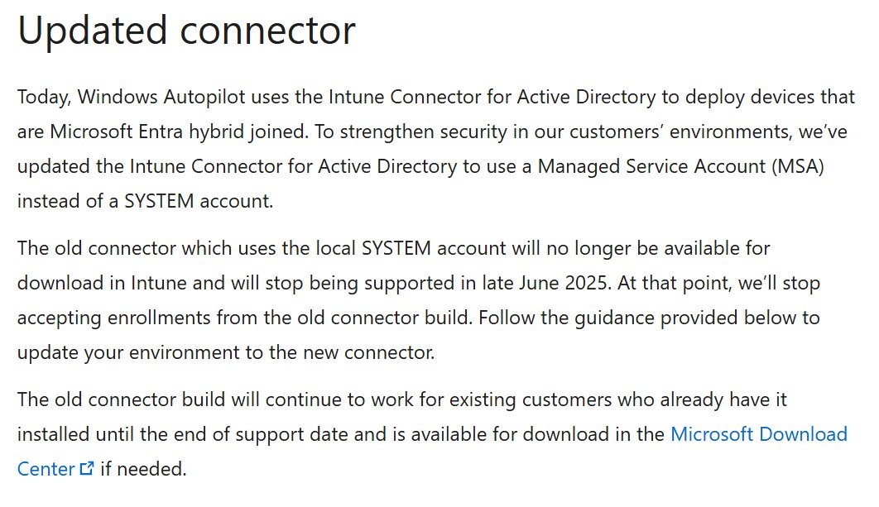
IMPORTANT: Intune Connector Update
Notes:
If you are doing hybrid Autopilot, you might want to check this out!​
Make sure to update your connector, otherwise it will stop working late June.

Slide 10
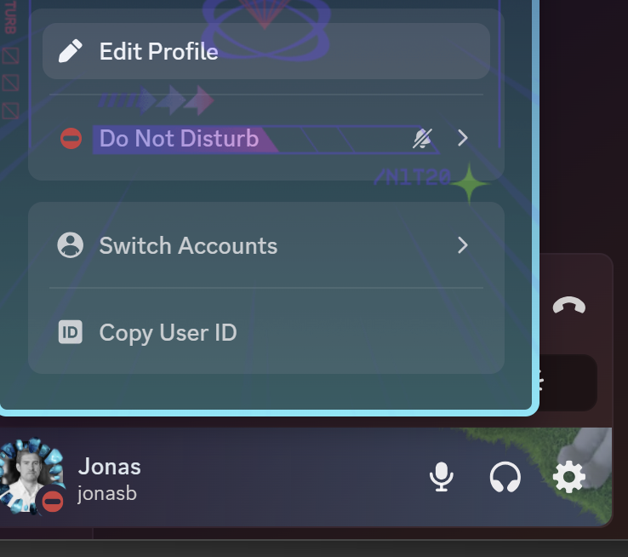


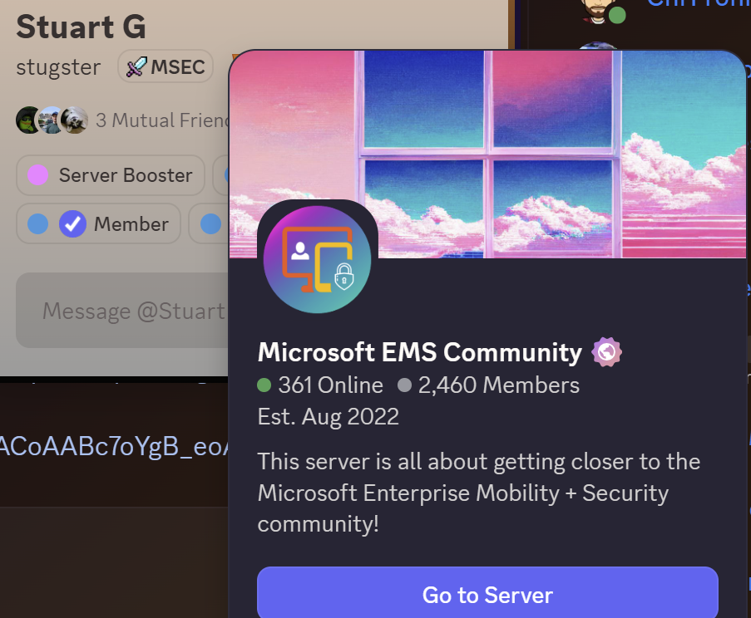
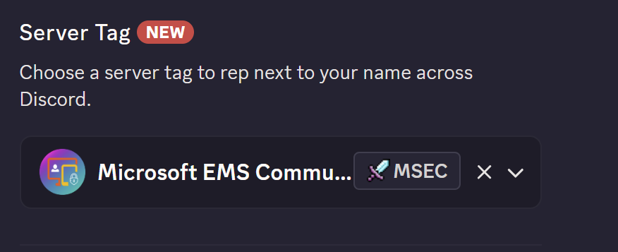
Discord Server tag
1
2

Slide 11
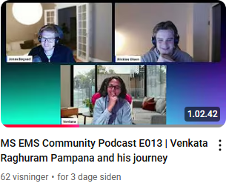
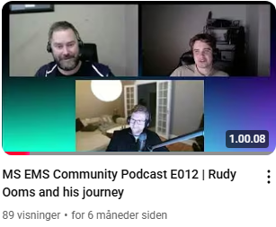
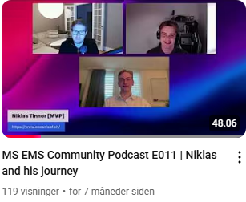
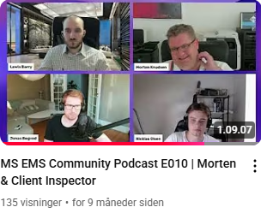
Want to join MS EMS Community Podcast?
Pre-recorded podcast about your journey and technical insights.
All from tech enthusiasts, Microsoft MVPs/employees and students!
Reach out to Jonas/Nicklas!

Slide 12
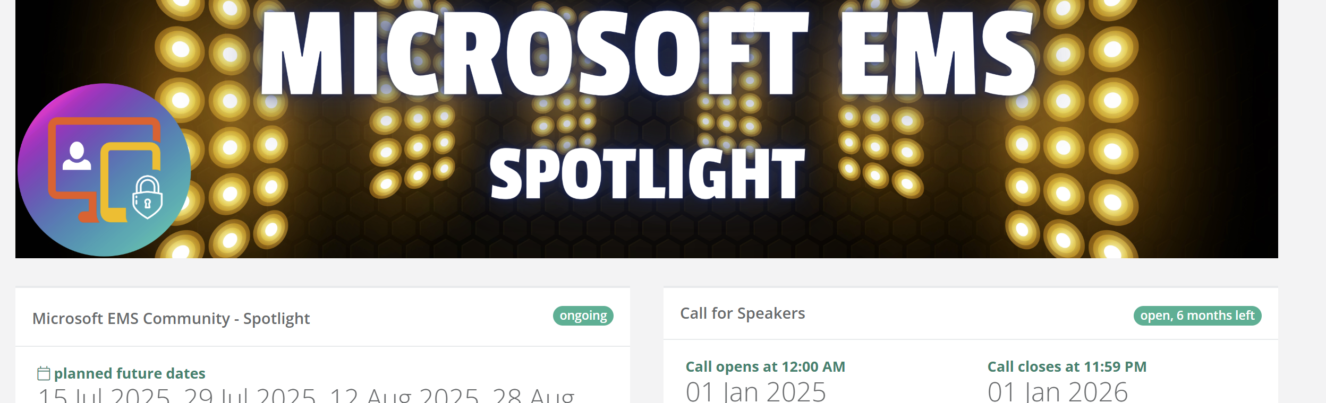
Want to a join Spotlight?
Do you have tools, ideas, or projects you’re passionate about?
Showcase your work
Refine your material and receive valuable feedback.
Expand your network and build visibility.
Sessions are typically 1 hour.
20-50 views

Slide 13
Agenda
Azure AD Graph Retirement
Open floor - bring any Microsoft Security topic you want!
Community Tools
Summer Plans 😎☀️🌞⛱️

Slide 14
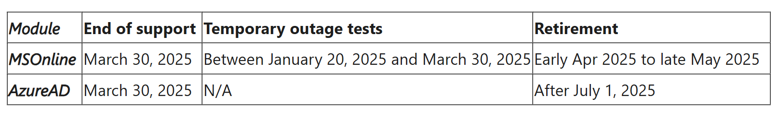
Azure AD Graph Retirement
Check in your Tenant if you got SPN calling Azure AD Graph API.
Migrate to Microsoft Graph API
Notes:
https://techcommunity.microsoft.com/blog/microsoft-entra-blog/action-required-msonline-and-azuread-powershell-retirement---2025-info-and-resou/4364991

Slide 15
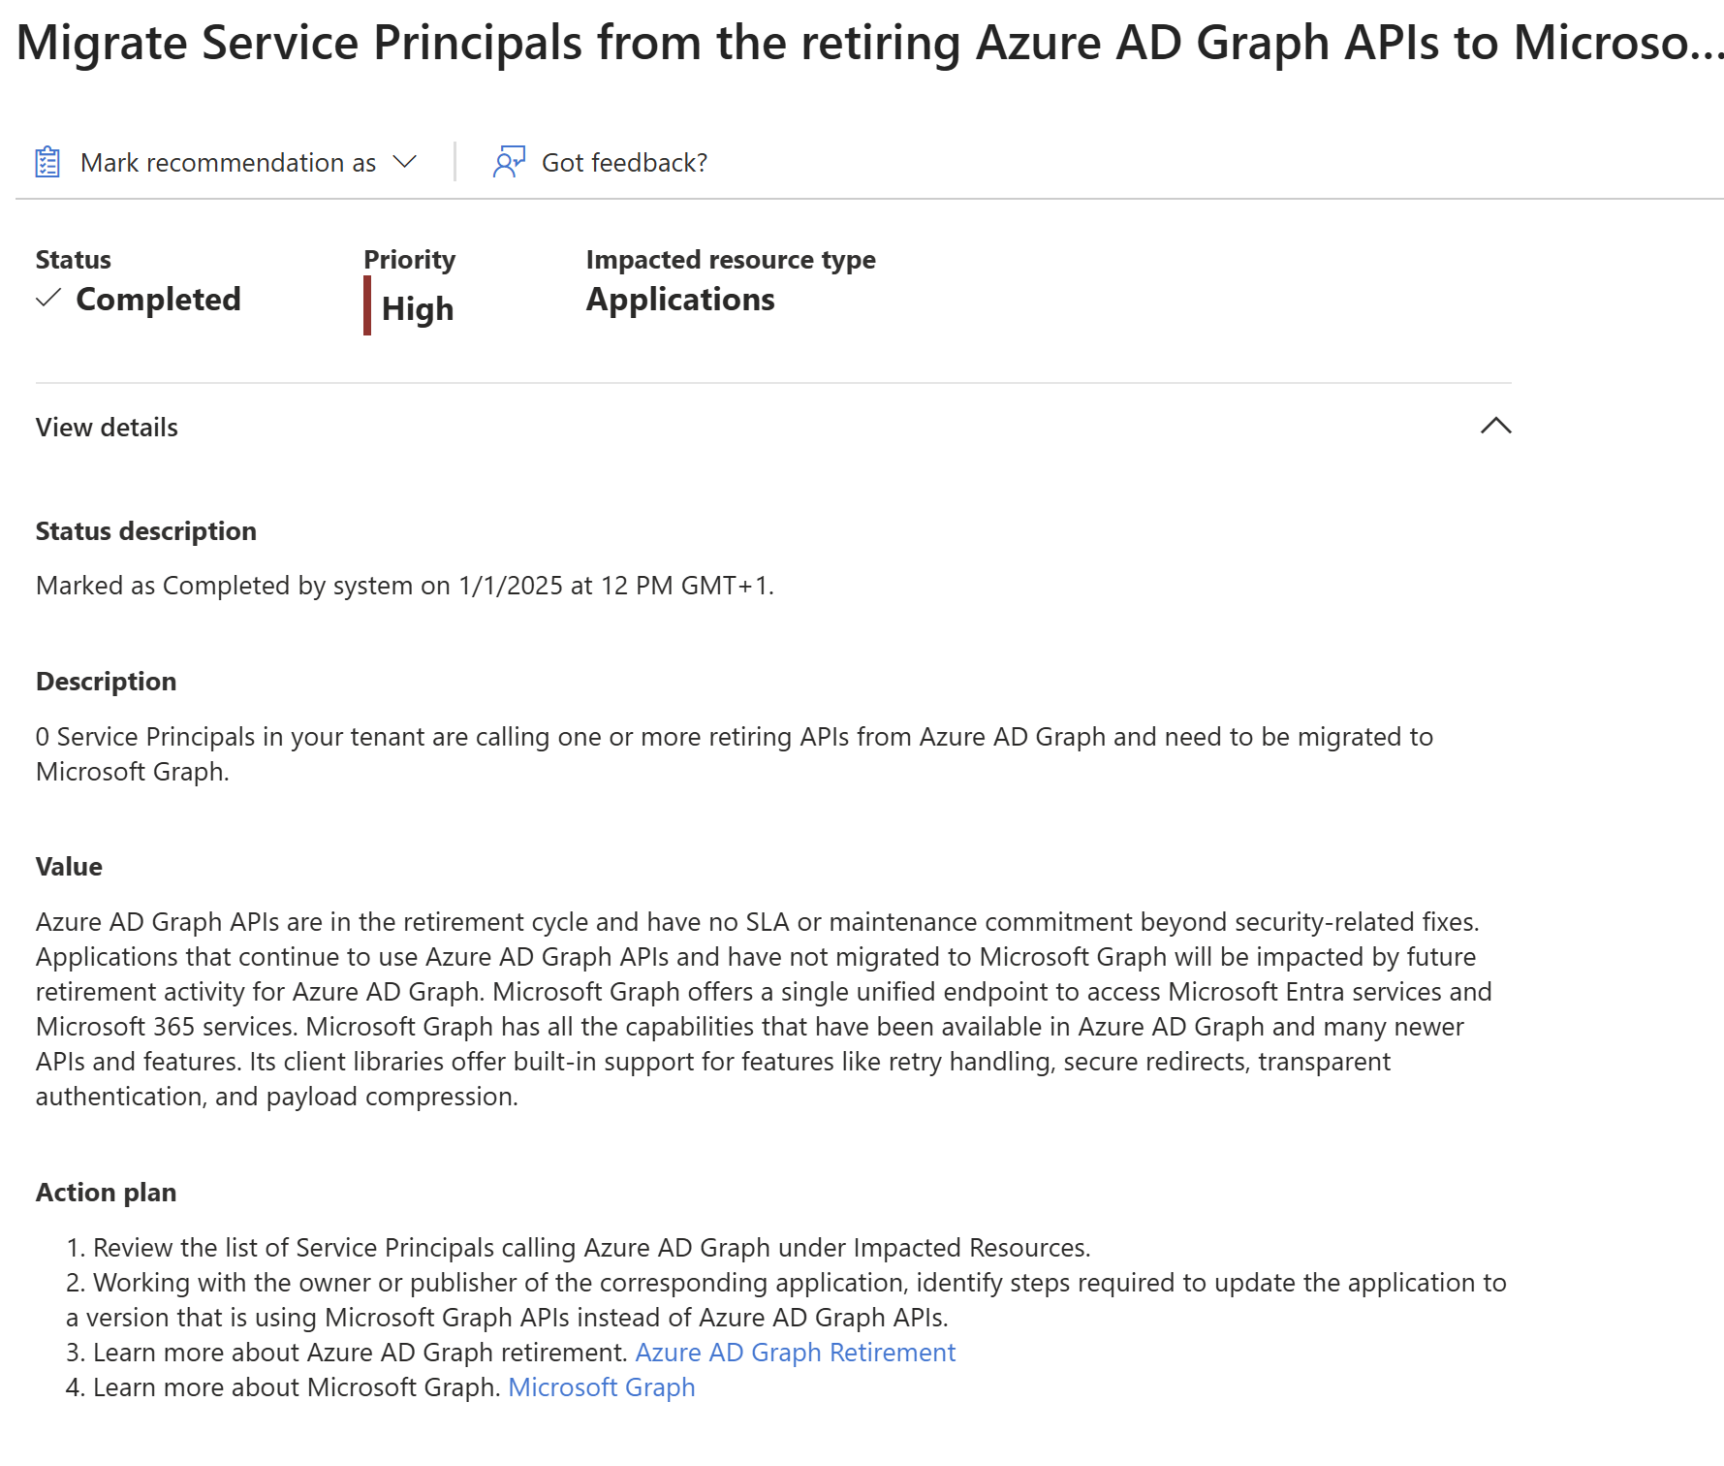
Important to note no Security related fixes.

Slide 16
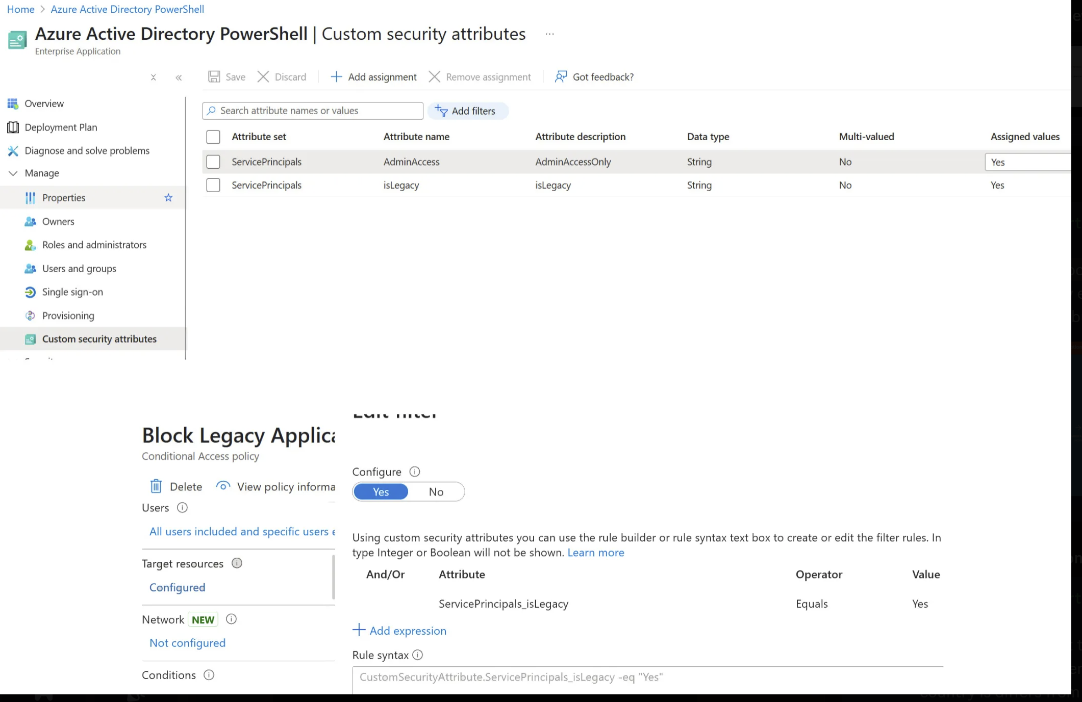

Slide 17
Community Tools
PowerShell AD Service Account Tool (by Michael Morten Sonne)
Setup Packager Intune (by TUGI aka. Tugay Taskin)
Envoy – Lightweight User Environment Manager (by Joey Verlinden)
iLaps for macOS (by Somesh Pathak)
Get-IntuneAssignments (by Amir Sayes)
Notes:
https://blog.sonnes.cloud/releasing-my-legacy-powershell-ad-service-account-tool-yes-it-still-works-great/
https://www.joeyverlinden.com/envoy-lightweight-user-environment-manager/
https://www.joeyverlinden.com/envoy-lightweight-user-environment-manager/
https://intuneirl.com/modern-macos-laps-secure-local-admin-password-management-with-intune-and-azure-key-vault/
https://amirsayes.co.uk/2025/05/01/is-this-group-even-being-used-introducing-get-intuneassignments/

Slide 18
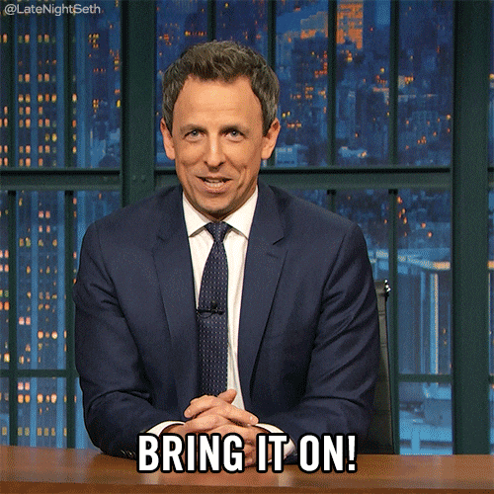
Open floor – bring it on!

Slide 19

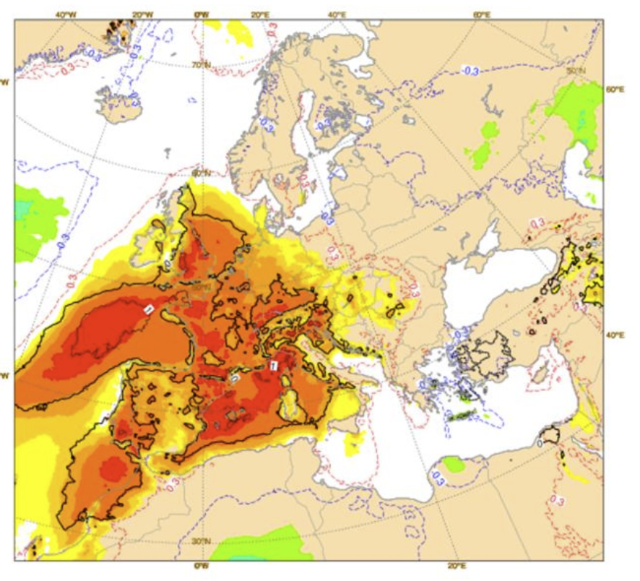
Summer Plans

